Slide 1
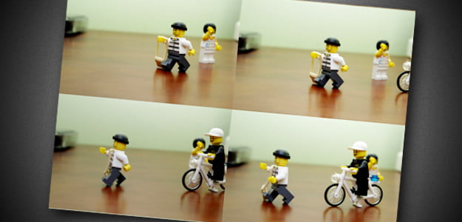
Lego stop motion task
Create your very own Lego stop motion action scene!
Use your cameras to take photos of your Lego scenes to create a story.

Slide 2
Example!
All of sudden the criminal grabbed the hand bag and started to run away.
It happened so quickly and the criminal even looked like he had a grin
on his face.
Little did he know a hero was in pursuit. Wearing a white cap and riding a
white bicycle he sped into action.

