Slide 1
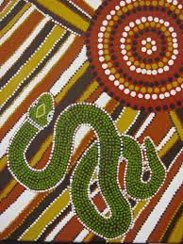
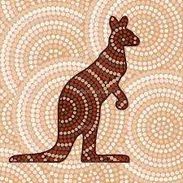
Aboriginal Art
^{The} ^{purpose} ^{of} ^{dot} ^{paintings –} ^{They} ^{tell} ª ^{story/ historical} ^{record} ^{of} ^{an} ^{event.....}
^{Traditionally} ^{Aboriginal People} ^{used dot} ^{paintings and} ^{other} ^{art} ^{forms to express} ^{feelings,} ^{history,} ^{and} ^{dreaming} ^{of} ^{their Culture.}
What am I going to learn?
Learn how Aboriginal people used dot paintings and other forms to express feelings, history, dreams and stories of their culture
Learn how to create a range of mark making techniques
Learn how to develop pattern through mark making
Learn basic colour theory
Primary/secondary colours
Learn how to describe warm and cool colours to show positive and negative space

Slide 2
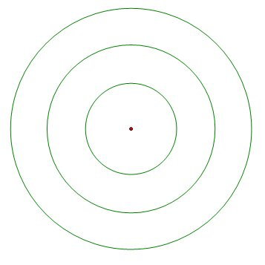

Slide 3
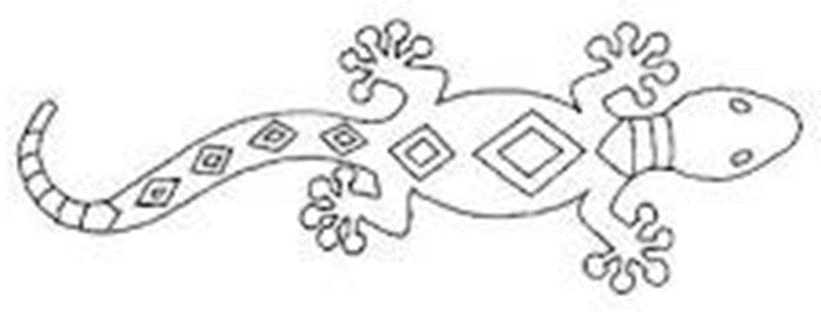

Slide 4
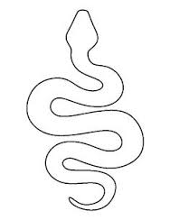

Slide 5
